Slide 1
Senior Masterpiece Presentation
By Leonell Lagumbay, EPH

Slide 2
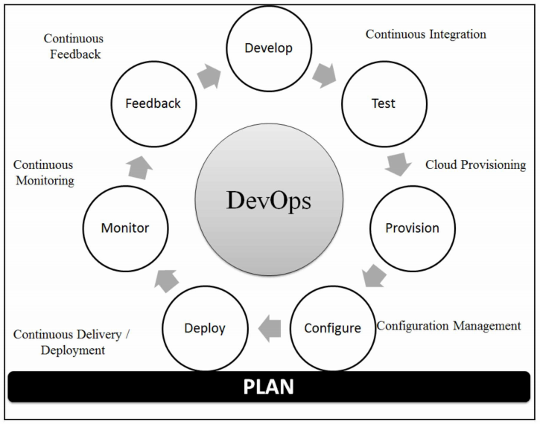

Slide 3
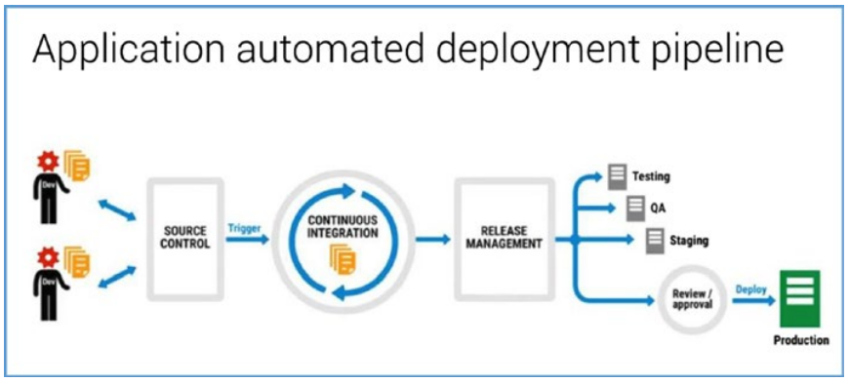

Slide 4
“The journey of a thousand miles begins with one step.”
-Lao Tzu, the father of Taoism

Slide 5
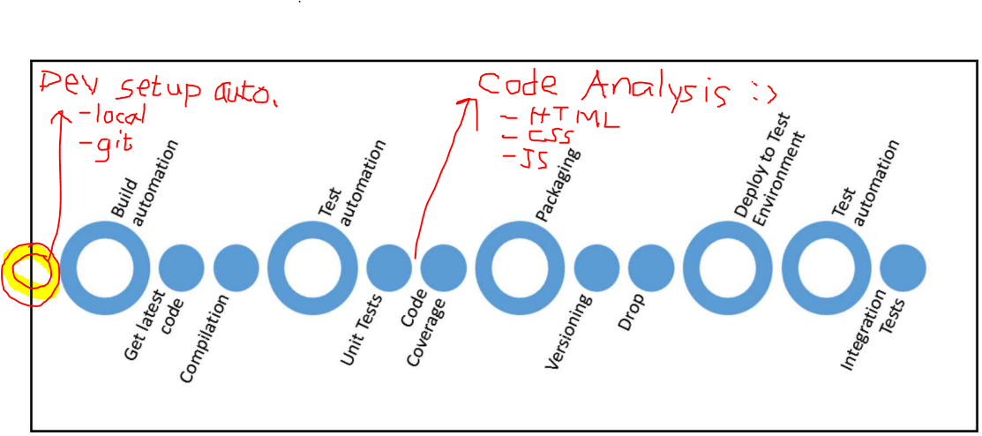
Sample continuous integration process

Slide 6
CI Overview

Slide 7

Continuous Integration
Continuous Integration (CI) is a software engineering practice where each check-in or push made by a developer is verified against automated build, static code analysis tools, and unit test execution.

Slide 8
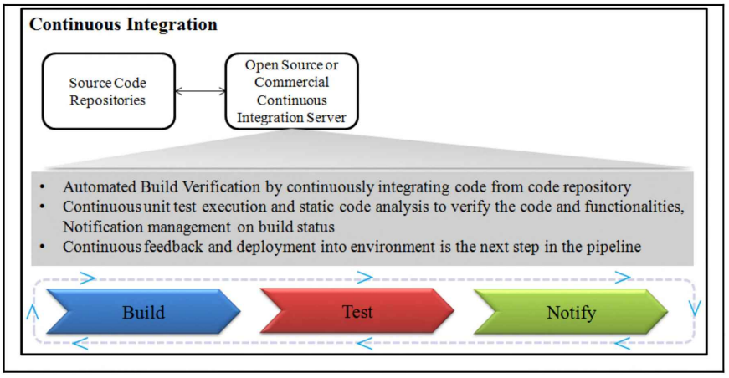
CI Process
A typical example configuration of continuous integration:
Build automation
Test automation
Notification

Slide 9
Web Apps Continuous Integration Demo
https://wiki.erninet.ch/display/SWi/How+to+start+Angular+project

Slide 10
Results Delivered
Frontend. What technology?
Single Page Application with Angular
TypeScript latest
Setup of Angular CLI
Separation of ViewModel (UI logic) and business logic (HTTP client, Domain model, and Validation
Support Dependency Injection
Unit test project
Integration tests using headless browser (optional)
Bootstrap (Font-Awesome)
Folder structure for CSS, images, Code scaffolding
SASS support
Multilingual support
Logging/Instrumentation (maybe Azure Application Insights)
Automatic code formatting with Prettier
RxJS, Lodash
Ionic, Ionic Native
Angular Material, Angular Flex Layout
Coding guidelines
Cross-browser CSS with autoprefixer and browserlist
What quality gates in CI?
Angular compilation (translate TypeScript, it generates app folder)
JavaScript minification
CSS minification
TSLint, CSSLint, SonarQube (HTMLHint, Codelyzer)
Run unit-tests
Run integration tests with headless browser
Run locally and VSTS server
Task automation
Sonar cloud
Sample MS web service
https://wiki.erninet.ch/pages/viewpage.action?spaceKey=SWi&title=Web+app+Continuous+Integration
https://wiki.erninet.ch/display/SWi/How+to+start+Angular+project

Slide 11
Phone number mystery
1. Write any 7 digit phone number
2. Take the first 3 digits and multiply by 80
3. Add 1
4. Multiply by 250
5. Add last 4 digits
6. Add last 4 digits again
7. Subtract by 250
8. Then divide by 2

Slide 12
Value

Slide 13

Value For Developers
Make things simple
Improve collaboration
Rapid project setup
Develop confidence
Documentation of coding guidelines
Quick feedback from customers

Slide 14
For ERNI
Quality
Provide more options to clients
Boost Marketing
For Clients
Agility
Increase client satisfaction
Adapt to agile/scrum framework
High quality product

Slide 15
“The first rule of any technology used in a business is that automation applied to an efficient operation will magnify the efficiency. The second is that automation applied to an inefficient operation will magnify the inefficiency.” -Bill Gates

